Slide 1
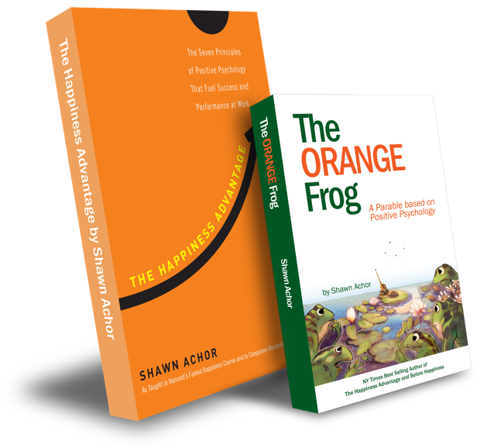
The Doubler

Slide 2
Week Four
The Doubler

Slide 3
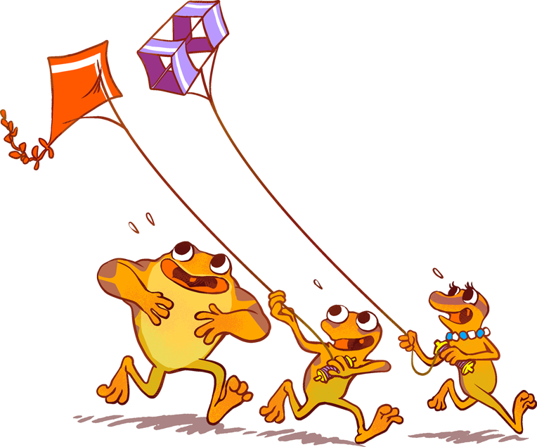
The Orange Frog
Learning Objective:
I can reflect back on my 21 day challenge and determine the importance of the “Doubler Tactic”.
I will discuss the importance of being able to look back and decide where the tactic had an impact on my life or not.
Notes:
Standard:
Essential Concept and/or Skill: Communicate and work productively with others emphasizing collaboration and cultural awareness to produce quality work.
Interact positively as a team member.
Cooperate with others in a group setting.
Generate ideas with group members.
Are active listeners.
Read and understand information in a variety of forms.
Express ideas.
Skill:
Active listening, express ideas

Slide 4
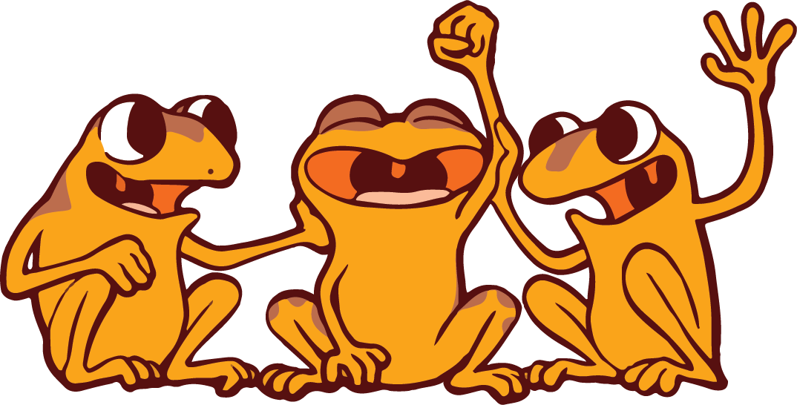
Skill
Communicate clearly
Use information creatively

Slide 5
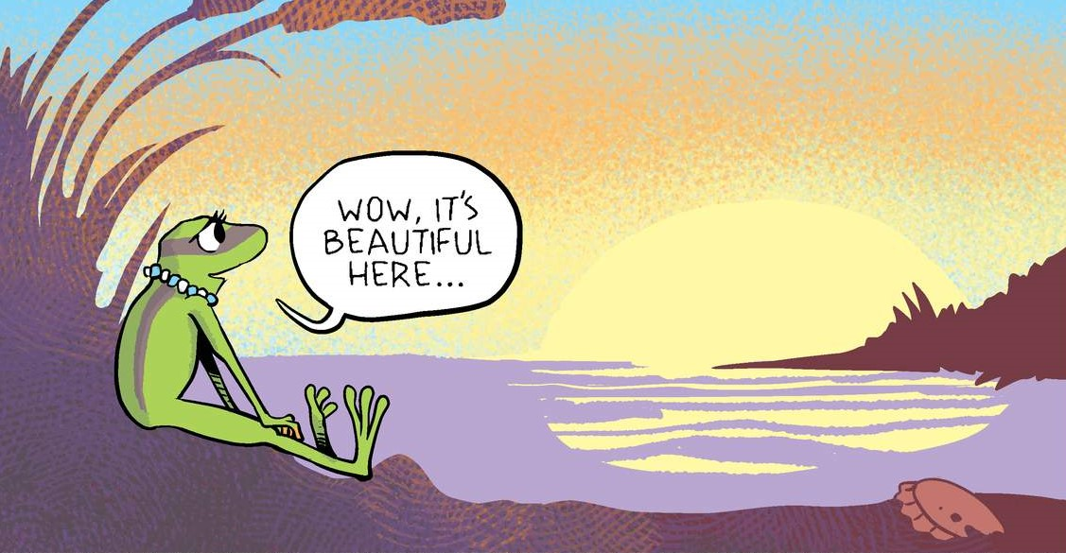
Opening Question
What does it mean to be reflective? OR
Are good at being reflective?
Notes:
You can either use this as a group activity and share on a projector or print out copies provided on the website for participants to cut and paste the pictures on their own.

Slide 6
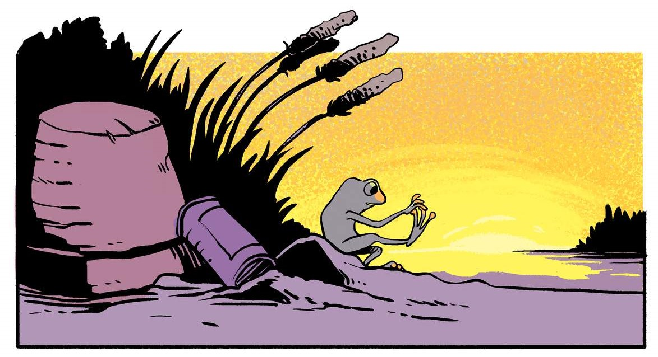
Thoughts
We have talked before about what it means to reflect. You can reflect by looking in a mirror or looking “behind” you. Reflecting is a way of looking at the way we do things, and deciding if we should do it the same next time, or change something.

Slide 7
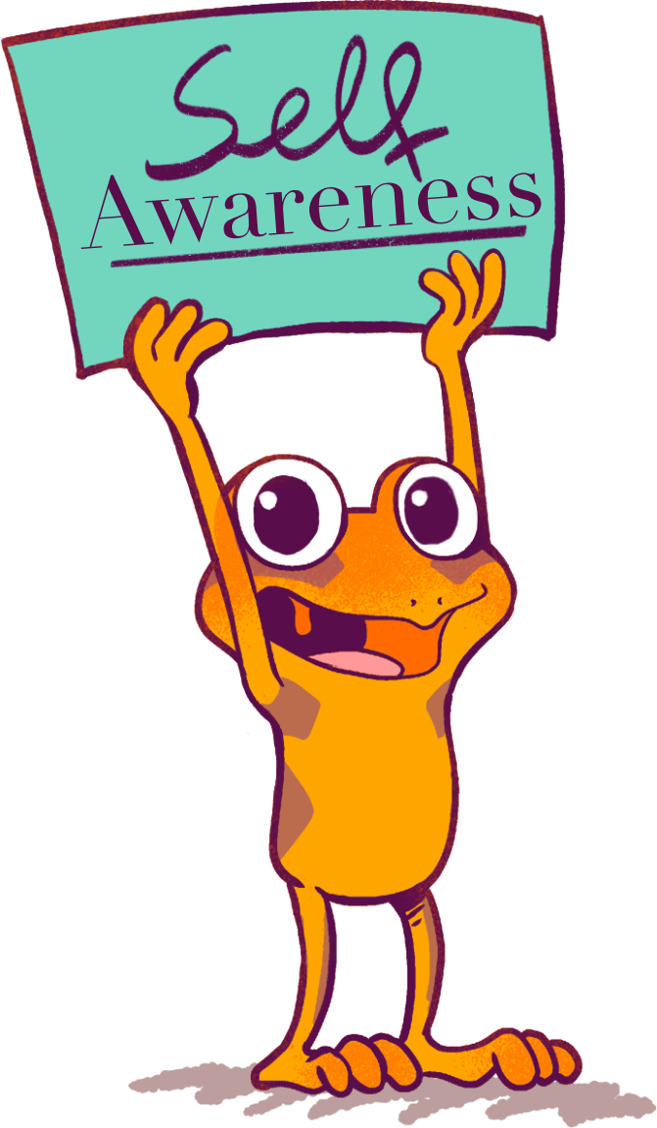
Action
Today, we are going to look back and reflect on the impact of the tactic. Not only are we going to do that, but we are going to develop a tool that younger grades could use to show their understanding of the “Doubler”.
Instructions
Create a Thermometer of Change that ranges from a big difference to a minimal difference. Explain that when we Glow and Grow, we look back and decide if the tactic made an impact.
Notes:
You can either use this as a group activity and share on a projector or print out copies provided on the website for students to cut and paste the pictures on their own.

Slide 8
WOW! What a big difference!
I can definitely feel a difference.
Maybe a little difference.
I don’t really feel a difference at all.

Slide 9
Bonus Questions
Was it difficult for you to reflect?
Do you think there was an overarching difference made?
What evidence do you have of a change?

